Slide 1
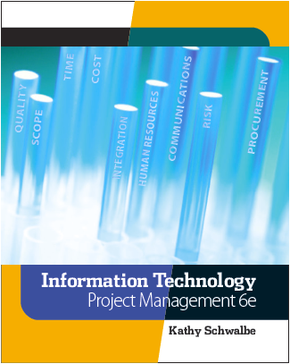
Chapter 11: Project Risk Management
Information Technology Project Management, Sixth Edition
Note: See the text itself for full citations.

Slide 2
Announcements
10/27 - Chapter 7, then team breakouts
11/3 - Chapter 8, then team breakouts
11/10 - Chapter 9, then team breakouts
11/17 - Chapter 10 & 11
11/24 - No Class Happy Thanksgiving
12/1 - Chapter 12
12/8 - Final Demo presented; Final reports due
12/15 - Final Exam

Slide 3
Learning Objectives
Understand what risk is and the importance of good project risk management
Discuss the elements involved in risk management planning and the contents of a risk management plan
List common sources of risks in information technology projects

Slide 4
Learning Objectives (continued)
Describe the process of identifying risks and be able to create a risk register
Discuss the qualitative risk analysis process and explain how to calculate risk factors, create probability/impact matrixes, and apply the Top Ten Risk Item Tracking technique to rank risks

Slide 5
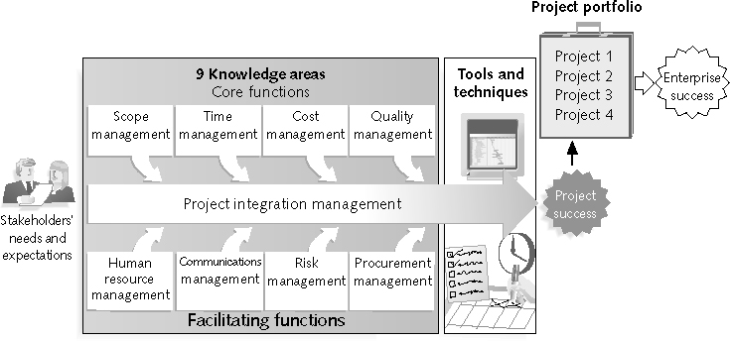
REVIEW: Project Management Framework – 9 Knowledge Areas

Slide 6
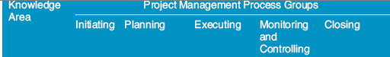
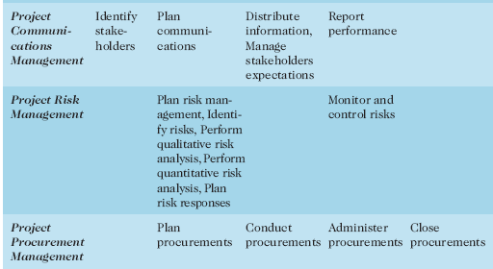
REVIEW:(continued)

Slide 7
Project Risk Management Processes
Planning risk management
Identifying risks
Performing qualitative risk analysis
Performing quantitative risk analysis
Planning risk responses
Monitoring and controlling risks

Slide 8
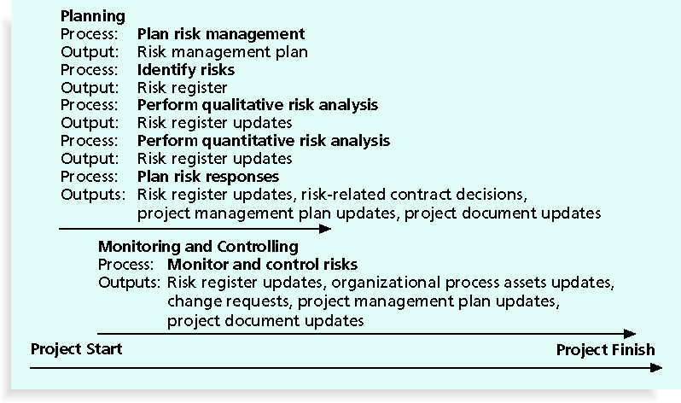
Figure 11-3. Project Risk Management Summary

Slide 9
The Importance of Project Risk Management
Project risk management is the art and science of:
Identifying
Analyzing
and Responding to risk throughout the life of a project
Risk management is often overlooked in projects, but it can help improve project success by helping select good projects, vendors, resources, fine tunning project scope, and developing realistic estimates

Slide 10
Table 11-1. Project Management Maturity by Industry Group and Knowledge Area*
KEY: 1 = LOWEST MATURITY RATING 5 = HIGHEST MATURITY RATING
Knowledge Area | Engineering/ Construction | Telecommunications | Information Systems | Hi-Tech Manufacturing
Scope | 3.52 | 3.45 | 3.25 | 3.37
Time | 3.55 | 3.41 | 3.03 | 3.50
Cost | 3.74 | 3.22 | 3.20 | 3.97
Quality | 2.91 | 3.22 | 2.88 | 3.26
Human Resources | 3.18 | 3.20 | 2.93 | 3.18
Communications | 3.53 | 3.53 | 3.21 | 3.48
Risk | 2.93 | 2.87 | 2.75 | 2.76
Procurement | 3.33 | 3.01 | 2.91 | 3.33
What does this show? Well that risk often gets overlooked in projects!

Slide 11
Negative Risk
A dictionary definition of risk is “the possibility of loss or injury”
Negative risk involves understanding potential problems that might occur in the project and how they might impede project success
Negative risk management is like a form of insurance; it is an investment

Slide 12
Risk Can Be Positive
Positive risks are risks that result in good things happening; sometimes called opportunities
A general definition of project risk is an uncertainty that can have a negative or positive effect on meeting project objectives
The goal of project risk management is to
minimize potential negative risks
while maximizing potential positive risks

Slide 13
Risk Utility
Risk utility or risk tolerance is the amount of satisfaction or pleasure received from a potential payoff
Tolerance decreases for people who are risk-averse (they don’t like risk – no risk – no reward)
Those who are risk-seeking have a higher tolerance for risk, and their satisfaction increases when more payoff is at stake (higher the risk, the higher the payout - usually)
The risk-neutral approach achieves a balance between risk and payoff – more calculated risks.

Slide 14
Project Risk Management Processes
Planning risk management: deciding how to approach and plan the risk management activities for the project
Identifying risks: determining which risks are likely to affect a project and documenting the characteristics of each
Performing qualitative risk analysis: prioritizing risks based on their probability and impact of occurrence

Slide 15
Project Risk Management Processes (continued)
Performing quantitative risk analysis: numerically estimating the effects of risks on project objectives
Planning risk responses: taking steps to enhance opportunities and reduce threats to meeting project objectives
Monitoring and controlling risks: monitoring identified and residual risks, identifying new risks, carrying out risk response plans

Slide 16
Risk Management Planning
The main output of risk management planning is a risk management plan, a plan that documents the procedures for managing risk throughout a project
The project team should review project documents and understand the organization’s and the sponsor’s approaches to risk, what is the orgs risk appetite – averse, neutral, high
The level of detail will vary with project needs

Slide 17
Table 11-2. Topics Addressed in a Risk Management Plan
Methodology
Roles and responsibilities
Budget and schedule
Risk categories
Risk probability and impact
Risk documentation

Slide 18
Contingency and Fallback Plans, Contingency Reserves
Contingency plans are predefined actions that the project team will take if an identified risk event occurs
Fallback plans are developed for risks that have a high impact on meeting project objectives and are put into effect if attempts to reduce the risk are not effective
Contingency reserves or allowances are provisions held by the project sponsor or organization to reduce the risk of cost or schedule overruns to an acceptable level

Slide 19
Broad Categories of Risk
Market risk
Financial risk
Technology risk
People risk
Structure/process risk

Slide 20
Risk Breakdown Structure
A risk breakdown structure is a hierarchy of potential risk categories for a project
Similar to a work breakdown structure but used to identify and categorize risks

Slide 21
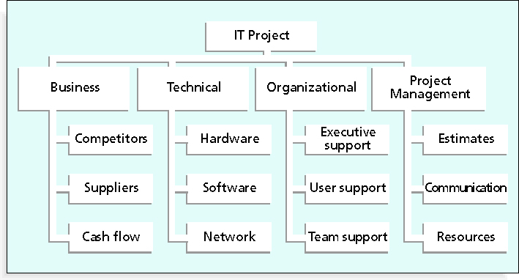
Figure 11-4. Sample Risk Breakdown Structure

Slide 22
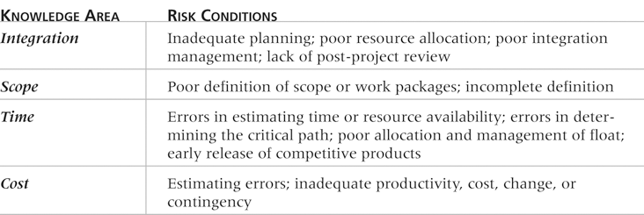
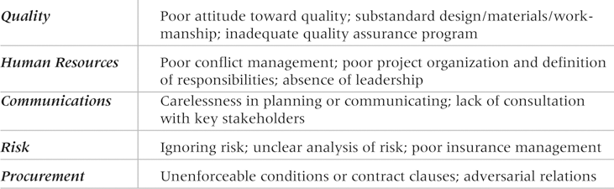
Table 11-4. Potential Negative Risk Conditions Associated with Each Knowledge Area

Slide 23
Identifying Risks
Identifying risks is the process of understanding what potential events might hurt or enhance a particular project
Risk identification tools and techniques include:
Brainstorming
Interviewing
SWOT analysis

Slide 24
SWOT Analysis
SWOT analysis (strengths, weaknesses, opportunities, and threats) can also be used during risk identification
Helps identify the broad negative and positive risks that apply to a project

Slide 25
Risk Register
The main output of the risk identification process is a list of identified risks and other information needed to begin creating a risk register
A risk register is:
A document that contains the results of various risk management processes and that is often displayed in a table or spreadsheet format
A tool for documenting potential risk events and related information
Risk events refer to specific, uncertain events that may occur to the detriment or enhancement of the project

Slide 26
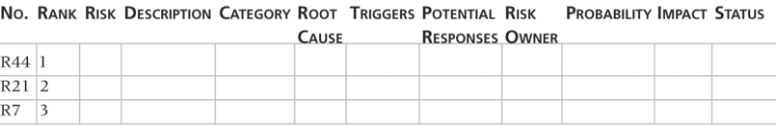
Table 11-5. Sample Risk Register

Slide 27
Performing Qualitative Risk Analysis
Assess the likelihood and impact of identified risks to determine their magnitude and priority
Risk qualification tools and techniques include:
Probability/impact matrixes
The Top Ten Risk Item Tracking
Expert judgment

Slide 28
Probability/Impact Matrix
A probability/impact matrix or chart lists the relative probability of a risk occurring on one side of a matrix or axis on a chart and the relative impact of the risk occurring on the other
List the risks and then label each one as high, medium, or low in terms of its probability of occurrence and its impact if it did occur
Can also calculate risk factors
Numbers that represent the overall risk of specific events based on their probability of occurring and the consequences to the project if they do occur

Slide 29
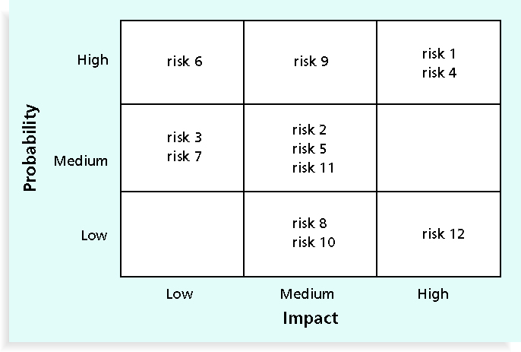
Figure 11-5. Sample Probability/Impact Matrix

Slide 30
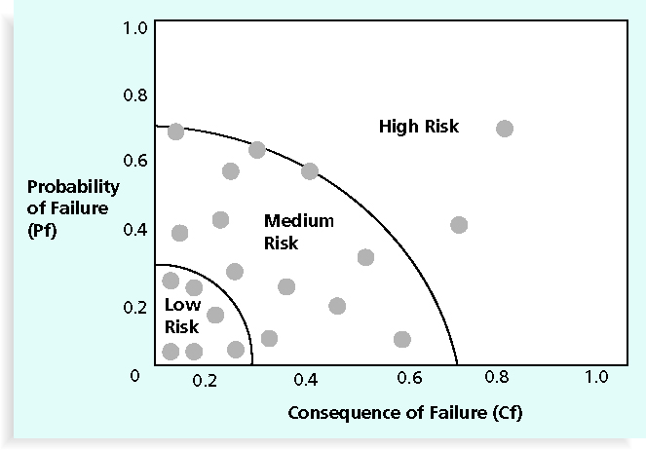
Figure 11-6. Chart Showing High-, Medium-, and Low-Risk Technologies

Slide 31
Watch List
A watch list is a list of risks that are low priority but are still identified as potential risks
Qualitative analysis can also identify risks that should be evaluated on a quantitative basis

Slide 32
Performing Quantitative Risk Analysis
Often follows qualitative risk analysis, but both can be done together
Large, complex projects involving leading edge technologies often require extensive quantitative risk analysis
Main techniques include:
Decision tree analysis
Simulation
Sensitivity analysis

Slide 33
Residual and Secondary Risks
It’s also important to identify residual and secondary risks
Residual risks are risks that remain after all of the response strategies have been implemented
Secondary risks are a direct result of implementing a risk response

Slide 34
Monitoring and Controlling Risks
Involves executing the risk management process to respond to risk events
Workarounds are unplanned responses to risk events that must be done when there are no contingency plans

Slide 35
Chapter Summary
Project risk management is the art and science of identifying, analyzing, and responding to risk throughout the life of a project and in the best interests of meeting project objectives
Main processes include:
Plan risk management
Identify risks
Perform qualitative risk analysis
Perform quantitative risk analysis
Plan risk responses
Monitor and control risks

